Slide 1
Lecture 21 – Introduction to Object-Oriented Programming (OOP)
OOP Terminology, Abstraction, Encapsulation, User defined types
Kok-Seng Wong | 2021

Slide 2

Motivation example 1
Name
He has…
Properties
Age
Talking
He can…
Behaviors
Singing
[source]

Slide 3

Motivation example 2
[source]

Slide 4
Learning outcomes
Upon the completion of this lecture, students will be able to:
explain the benefits of object-oriented design and understand when it is an appropriate methodology to use.
understand the basic concept (i.e., object, class, abstraction, and encapsulation) of object-oriented programming.

Slide 5
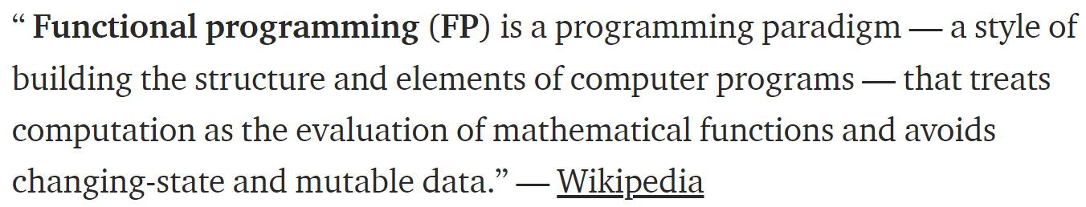
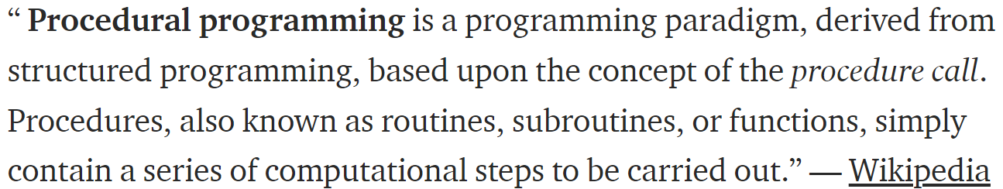
Programming styles (1/2)

Slide 6
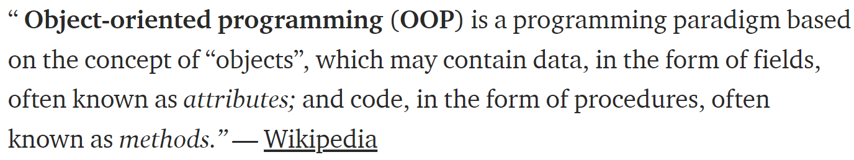
Programming styles (2/2)

Slide 7
Why oop?

Slide 8
Student | Name | Major | Quiz 1 | Quiz 2 | Midterm
1 | Ali Baba | CS | 21 | 23 | 12
2 | Alo Baba | ME | 12 | 33 | 50
3 | Alu Baba | EE | - | 32 | 21
std1 = ["Ali Baba", "CS", 21, 23, 12]
std2 = ["Alo Baba", "ME", 21, 33, 50]
std3 = ["Alu Baba", "EE", 32, 21]
>>> std3[2]
32
Quiz 2 score instead of Quiz 1

Slide 9
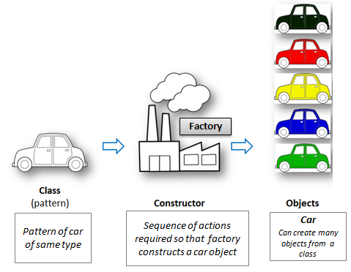
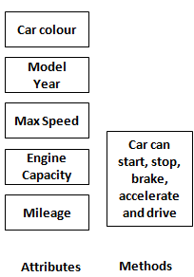
Oop overview
[source]

Slide 10
Overview of OOP terminology (1/3)
Class − A user-defined prototype for an object that defines a set of attributes that characterize any object of the class. The attributes are data members (class variables and instance variables) and methods, accessed via dot notation.
Class variable − A variable that is shared by all instances of a class. Class variables are defined within a class but outside any of the class's methods. Class variables are not used as frequently as instance variables are.
Data member − A class variable or instance variable that holds data associated with a class and its objects.
[source]

Slide 11
Overview of OOP terminology (2/3)
Function overloading − The assignment of more than one behavior to a particular function. The operation performed varies by the types of objects or arguments involved.
Instance variable − A variable that is defined inside a method and belongs only to the current instance of a class.
Inheritance − The transfer of the characteristics of a class to other classes that are derived from it.
Instance − An individual object of a certain class. An object obj that belongs to a class Circle, for example, is an instance of the class Circle.
[source]

Slide 12
Overview of OOP terminology (3/3)
Instantiation − The creation of an instance of a class.
Method − A special kind of function that is defined in a class definition.
Object − A unique instance of a data structure that's defined by its class. An object comprises both data members (class variables and instance variables) and methods.
Operator overloading − The assignment of more than one function to a particular operator.
[source]

Slide 13
Object-oriented programming
The key to object-oriented programming (OOP) is thinking about objects as collections of both data and the methods that operate on that data.
An object could represent a person with properties like a name, age, race, and address and behaviors such as walking, talking, breathing, singing, and running.

Slide 14
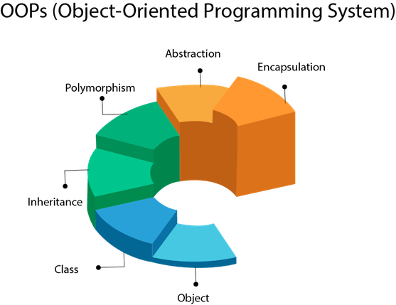
OOP concepts
Group Discussion
Group 7, 8, & 9
Group 10, 11, 12
Group 4, 5, & 6
Group 1, 2 & 3
[source]

Slide 15


Class and object
defines the characteristics and behavior of its data members and member functions
Instance of the class
objects
class
car
[source]
built

Slide 16
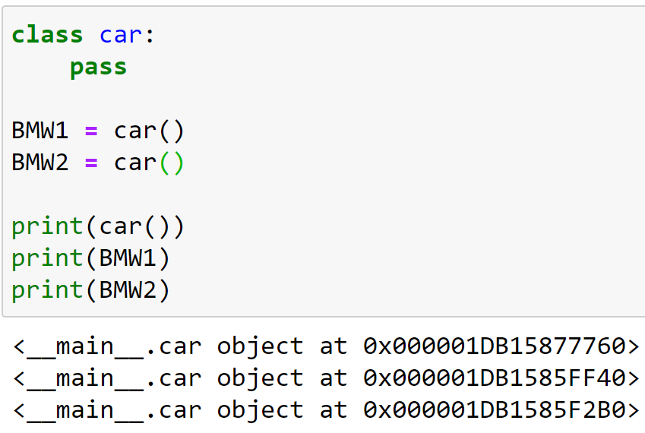
Class and objects memory
Objects’ memory

Slide 17
Attributes and methods
When working with an object, variables are called attributes and functions are called methods.
Object
Property
(attributes)
Method
(functions)

Slide 18
abstraction
A concept of object-oriented programming that shows only important attributes while hiding unnecessary details from the user.
It helps in reducing programming complexity and increase efficiency.

Slide 19

Abstraction: real-life example
We use ATM machine for operations such as cash withdrawal and money transfer, but we never know what exact actions or operations takes place internally in the machine.
[source]

Slide 20
encapsulation
Encapsulation is a programming technique that binds the class members together and prevents them from being accessed by other classes.
Restricted access to Class members: variables and methods
To keep variables and methods safes from outside interference and misuse.

Slide 21
Encapsulation: real-life example
Suppose you have an account in the bank. The balance variable is declared as private so that only the person who has to see his account balance, will have to access only private members through methods defined inside that class.
The method will ask for account number, user ID and password for authentication.

Slide 22
Advantages of encapsulation
The functionality is defined in one place and not in multiple places.
It is defined in a logical place – the place where the data is kept.
Data inside an object is not modified unexpectedly by external code in a completely different part of our program.
When we use a method, we only need to know what result the method will produce – we don’t need to know details about the object’s internals in order to use it.

Slide 23
Abstraction vs encapsulation
Abstraction focuses on components that are required to construct a system while encapsulation focuses on hiding the complexity of the system.
The abstraction is done during the design level of a system and encapsulation is done when the system has been implemented.
Abstractions main motive is, what’s to be done in order to build a system while Encapsulations main motive is, how it should be done to construct a system.
Abstraction is achieved by encapsulation whereas, the encapsulation is achieved by making the elements of the system private.

Slide 24
Creating classes
To create user-defined data structures

Slide 25
Class definition
Creating a new class creates a new type of object, allowing new instances of that type to be made.
class <class-name>():
"""class specification"""
<method definitions>

Slide 26
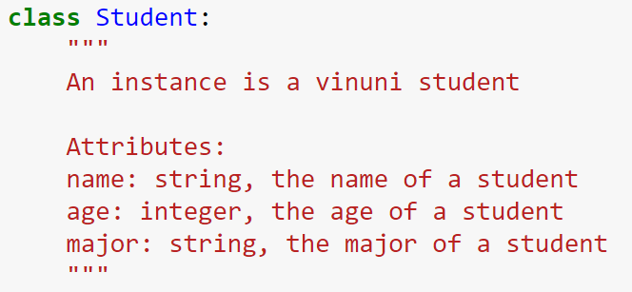
Class definition: specification
Creates a new class called Student
keyword
Brief summary
Description
Attributes list
Attribute’s name

Slide 27
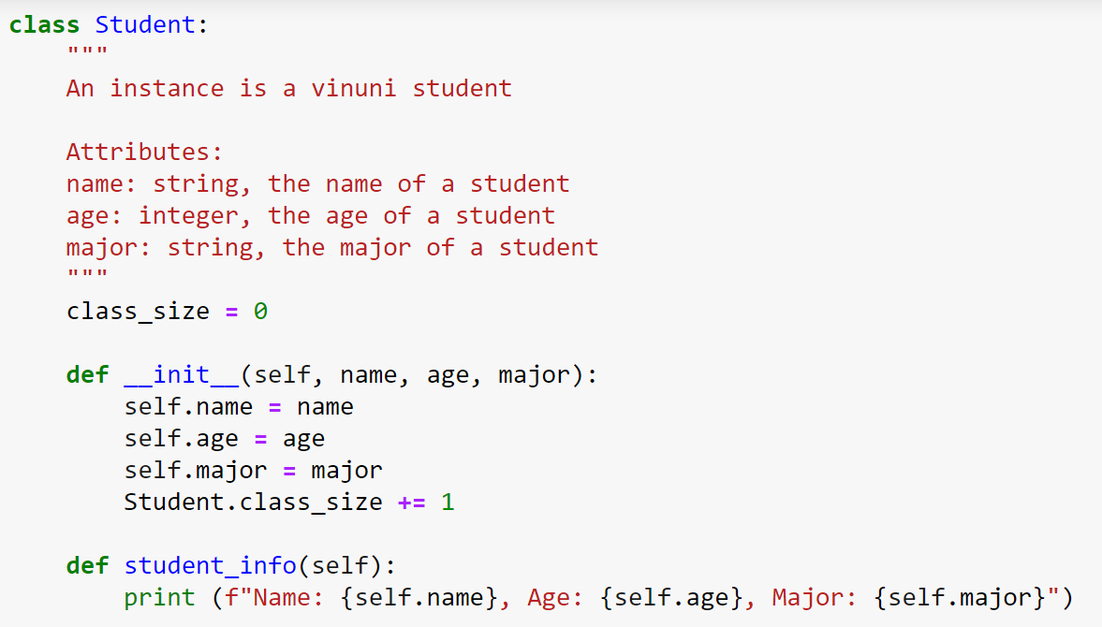
Class definition: method
class variable (class attribute): can be accessed from inside or outside the class
Class constructor (also known as initialization method)
Instance method

